Slide 1

Natural Language Processing and its application on Sentiment Analysis
By: Adrian, Juriel, Pam, and Paul

Slide 2

CorpuS
A corpus is a collection of authentic text or audio collected for a particular research project. It can be thought of as a paragraph, which is composed of sentences called documents, which then are composed of vocabularies, which are all the unique words found in all sentences.
In Natural Language Processing, a corpus is transformed into a dataset, which contains text and speech data that can be used to train AI and machine learning systems, and with labels for supervised learning.

Slide 3
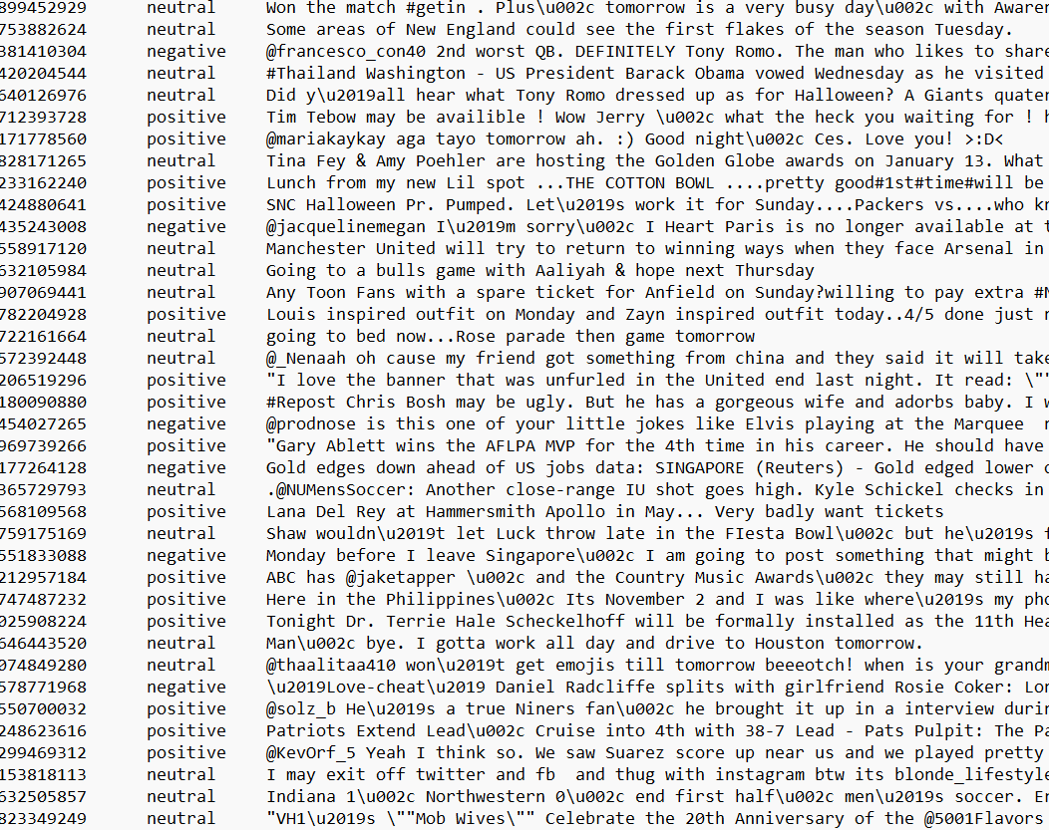
An example of a corpus transformed into a dataset
2013 Twitter Dataset
Part of the 2013 to 2016 twitter dataset compiled as part of the SemEval-2017 Task 4 Competition: Sentiment Analysis on Twitter

Slide 4
From text to vectors
DATASET
PREPROCESSING 1
PREPROCESSING 2
VECTORIZATION

Slide 5

BAG OF WORDS
It’s the simplest model (aside from one hot encoding), and the idea is to take the whole text data and count their frequency of occurrence. and map the words with their frequency. This method doesn’t care about the order of the words, but it does care how many times a word occurs, and the default bag of words model treats all words equally.
Disadvantages:
Sparsity
Ordering is not captured
No information is retained
Out of vocabulary problem exists

Slide 6
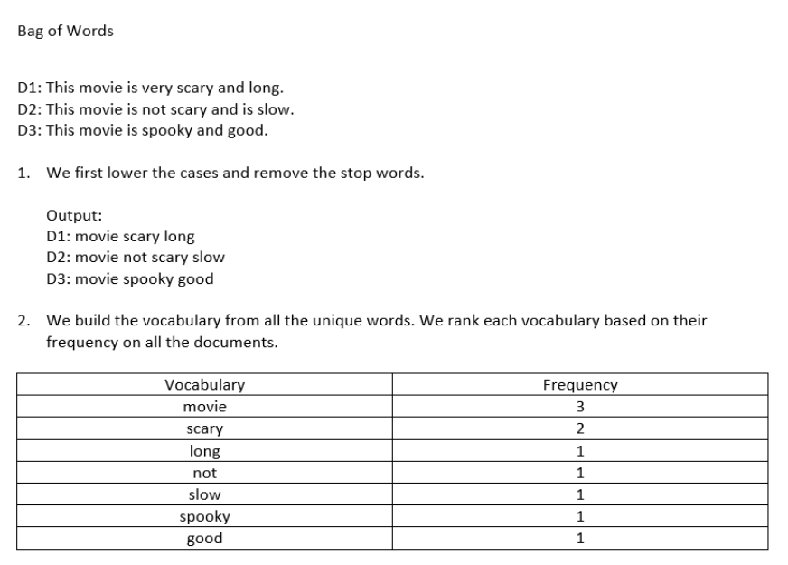
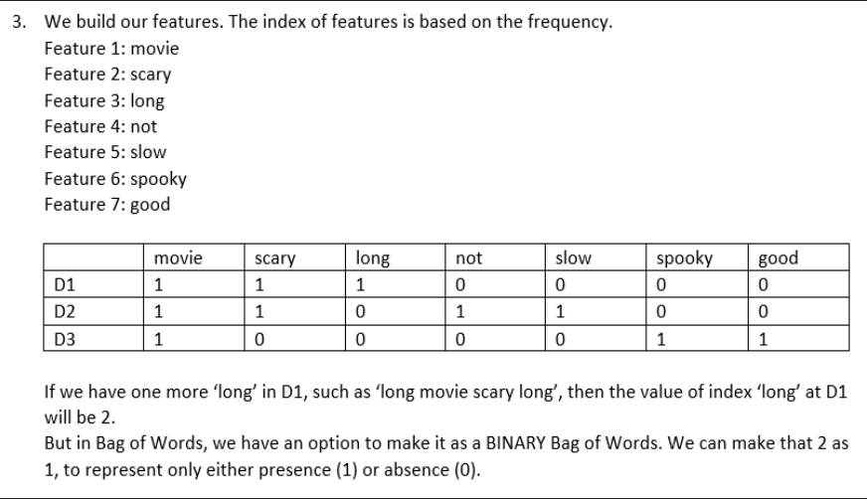

Slide 7
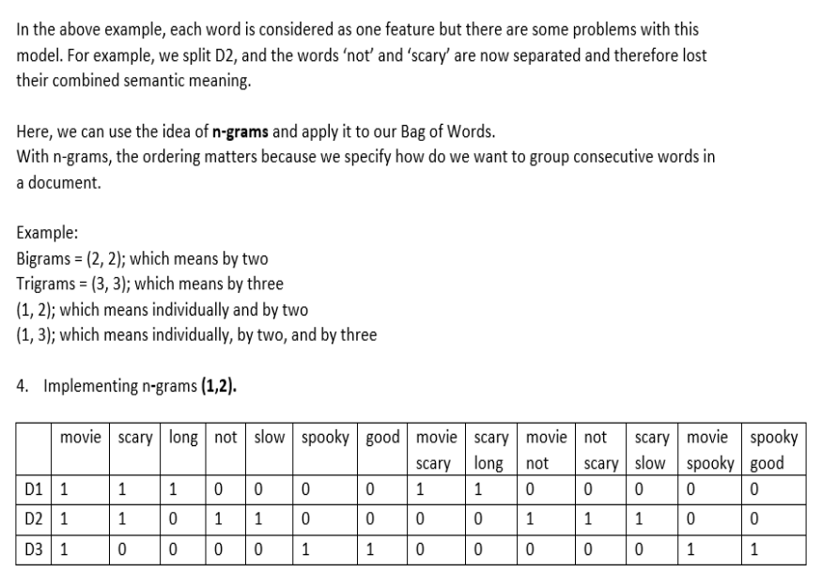

Slide 8
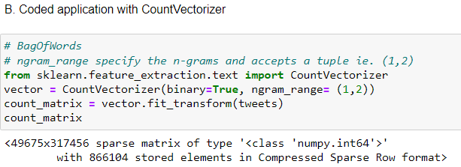

Slide 9
Tf-idf
The BOW model doesn’t give good results since it has a drawback. Assume that there is a particular word that is appearing in all the documents, and it comes multiple times, eventually, it will have a higher frequency of occurrence and it will have a greater value that will cause a specific word to have more weightage in a sentence, that’s not good for our analysis.
The idea of TF-IDF is to reflect the importance of a word to its document or sentence by normalizing the words which occur frequently in the collection of documents.
Advantages:
1. Simple and intuitive
2. Word importance is captured
3. It performs much better for machine learning models than simple Bag of Words.
Disadvantages:
1. Sparsity is still present, but much less than Bag of Words.
2. Out of vocabulary problem is still not handled.

Slide 10
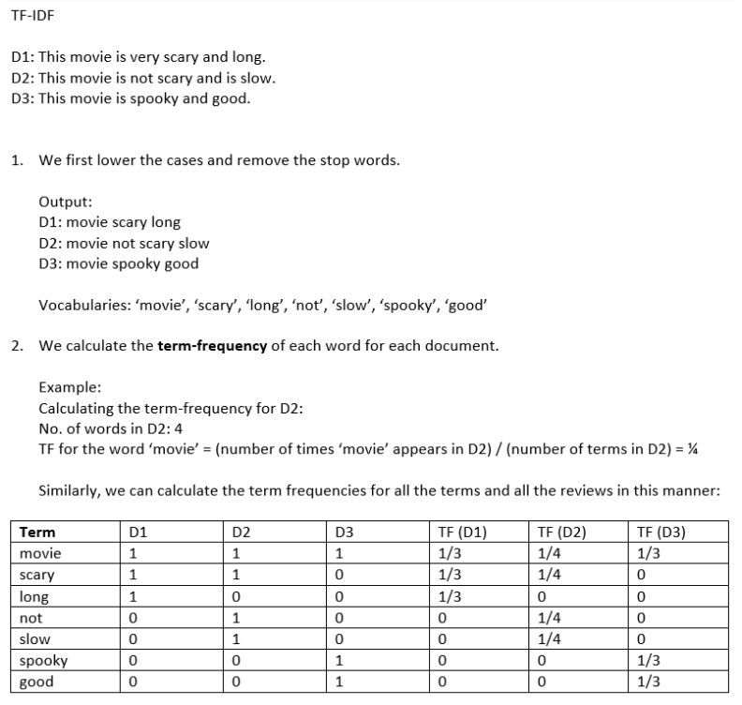

Slide 11
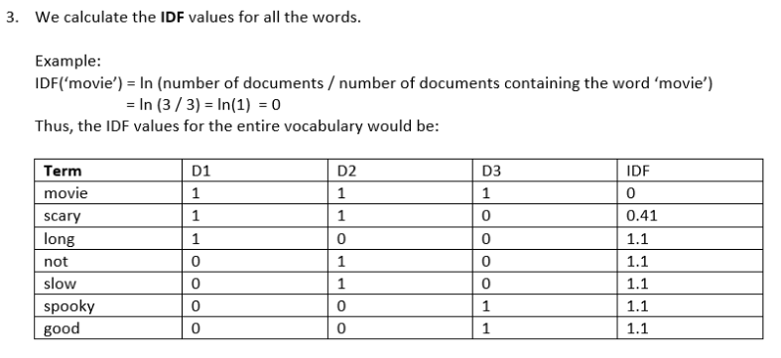
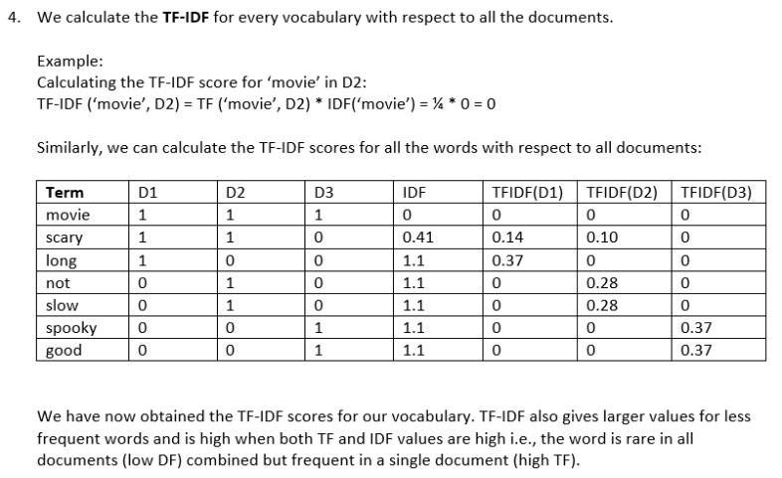

Slide 12
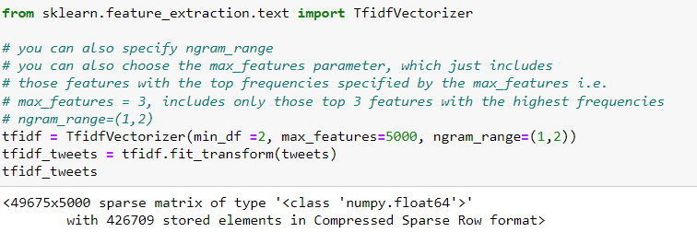

Slide 13

Word embedding
Word embeddings are a type of word representation that allows words with similar meaning to have a similar representation.
It is an improvement over more the traditional bag-of-word model encoding schemes where large sparse vectors were used to represent each word or to score each word within a vector to represent an entire vocabulary. These representations were sparse because the vocabularies were vast, and a given word or document would be represented by a large vector comprised mostly of zero values.
Key to the approach is the idea of using a dense distributed representation for each word.

Slide 14

Word embedding: word2vec
Word2Vec is the combination of two techniques:
a. Continuous Bag of Words
b. Skipgram
Both of these are shallow neural networks (1 hidden layer) which learn the weights, which then act as word vector representations when multiplied to the onehot-encoded versions of the target vocabulary.
Predicting a target word (CBOW) and predicting the context/surrounding words given a word (Skipgram) are just "fake problems" we are trying to solve. What we are interested in is the side effect, which is the word embedding vector, or the weights generated by the neural network in solving that fake problems.

Slide 15
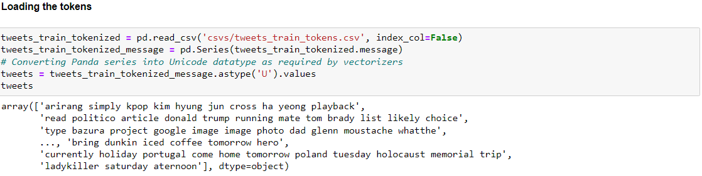
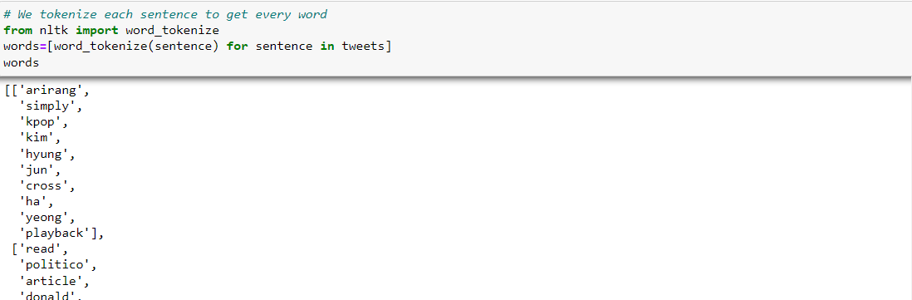

Slide 16
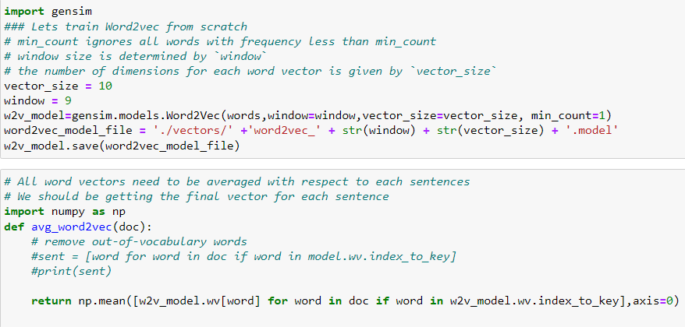

Slide 17
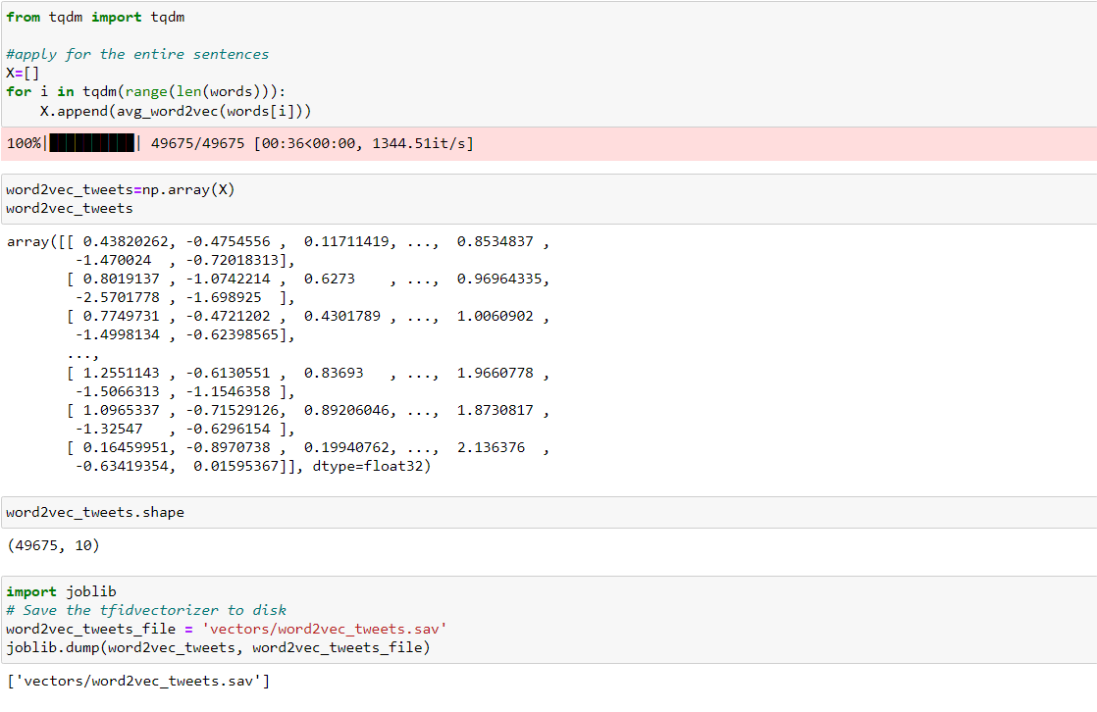

Slide 18
DOCUMENT EMBEDDING
Document Embedding is a technique which tries to provide vector representations to larger units of texts - from sentences to books.
A document refers to any sequence of words, ranging from sentences and paragraphs through social media posts all the way to articles, books, and more complexly structured text documents such as forms.

Slide 19
DOCUMENT EMBEDDING: DOC2VEC
Paragraph Vectors: Distributed Memory (PV-DM)
- The training task here is quite similar to that of continuous bag of words; a single word is to be predicted from its context. In this case, the context words are the preceding words, not the surrounding words, as is the paragraph.
b. Paragraph Vectors: Distributed Bag of Words (PV-DBOW)
- It is a parallel of word2vec's skipgram architecture, the classification task is to predict a single context word using only the paragraph vector.

Slide 20
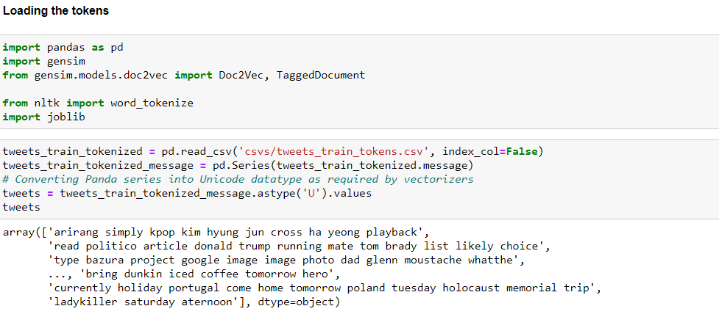
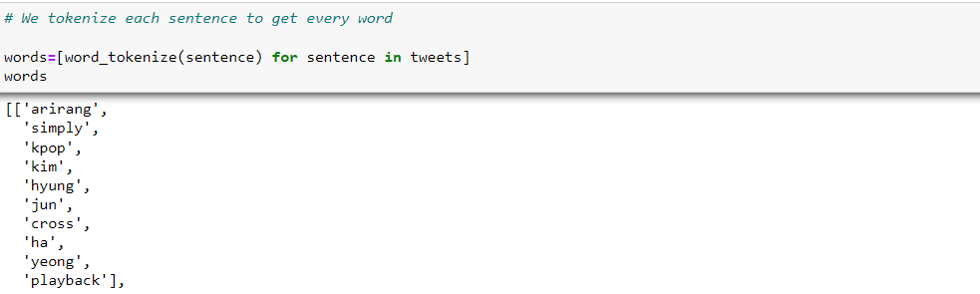

Slide 21
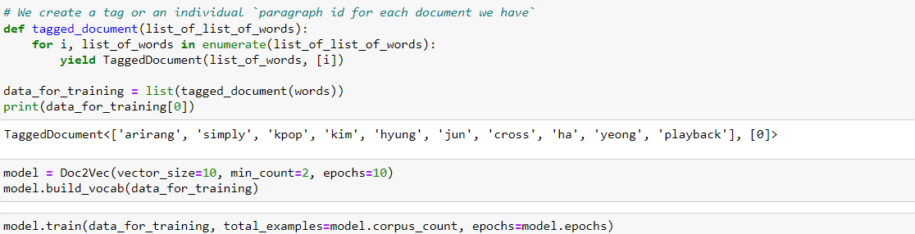
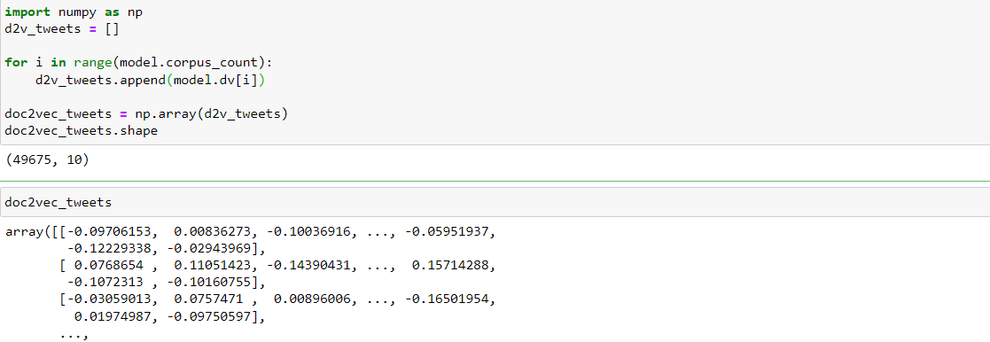

Slide 22
Contextual embedding
Contextual Embedding tries to represent words into vectors, based on the context by which they appear. A word that appears on two different contexts, such as:
Manila is the capital of the Philippines.
Protect your capital, profits just follow.
“capital” have different meanings and thus must have different vector representations in order to capture this information.
This is accomplished through what is called a Transformer.
It is an encoder-decoder architecture, which works through a sequence-to-sequence learning using an “attention” mechanism.
This searches for the context around words in the input sequence, instead of just running through the sequence of tokens in order.

Slide 23
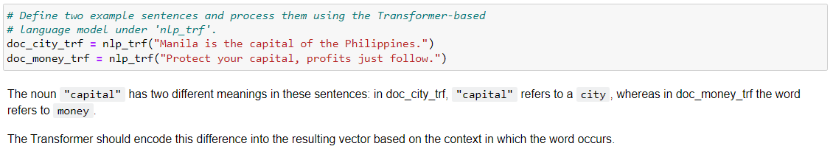
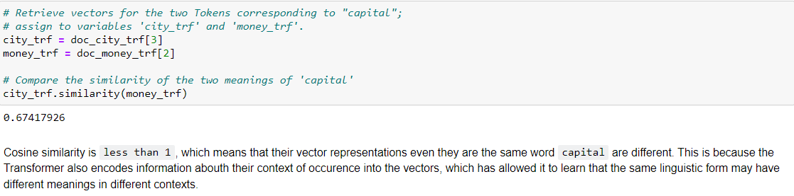

Slide 24
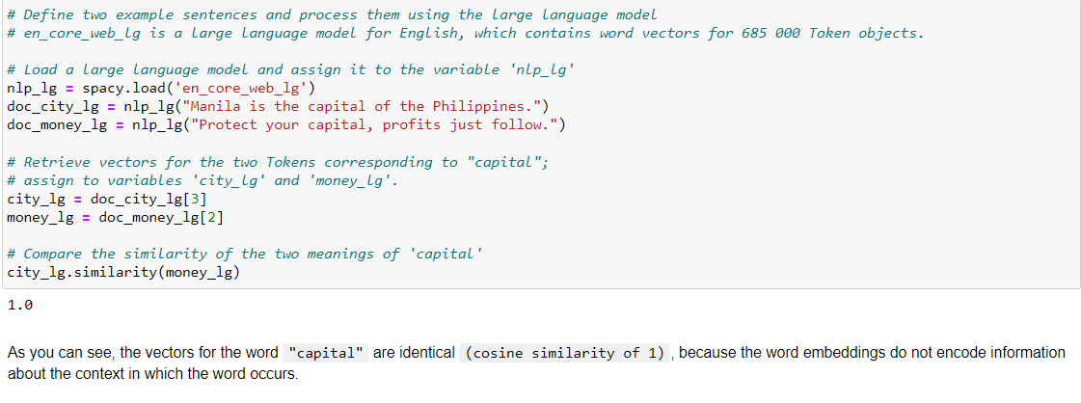
Word embeddings do not capture this difference in context

Slide 25
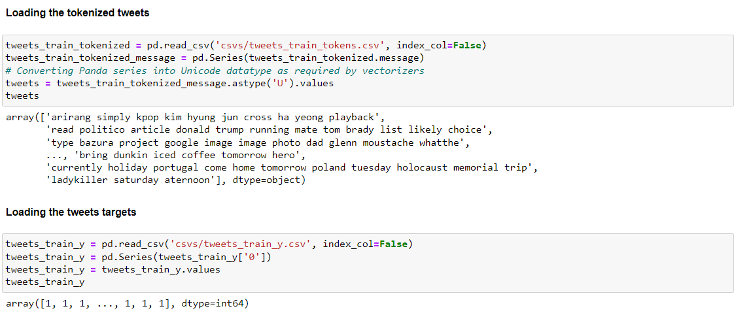
EVALUATION OF TEXT-TO-VECTORS TECHNIQUES

Slide 26
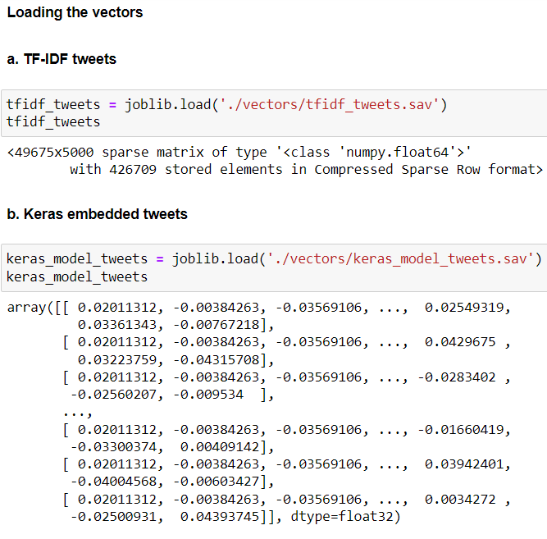
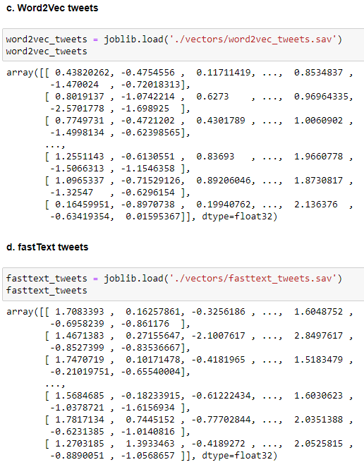
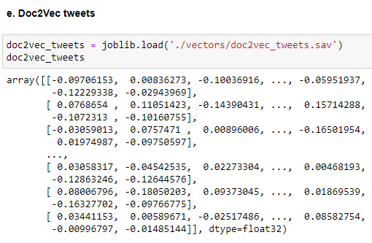

Slide 27
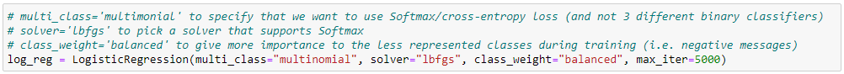
The baseline model: logistic regression

Slide 28
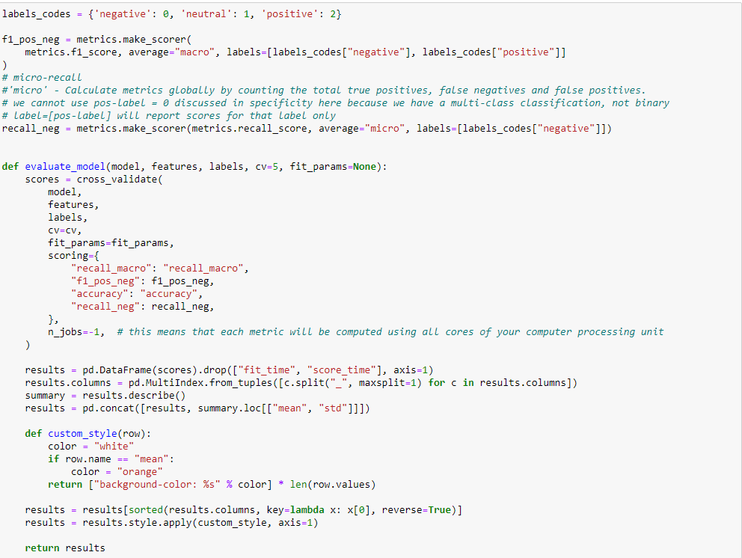
The Evaluation Function

Slide 29
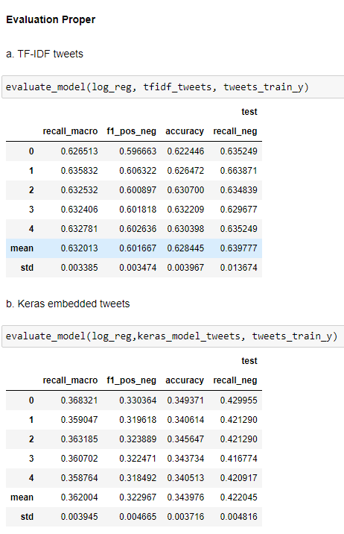
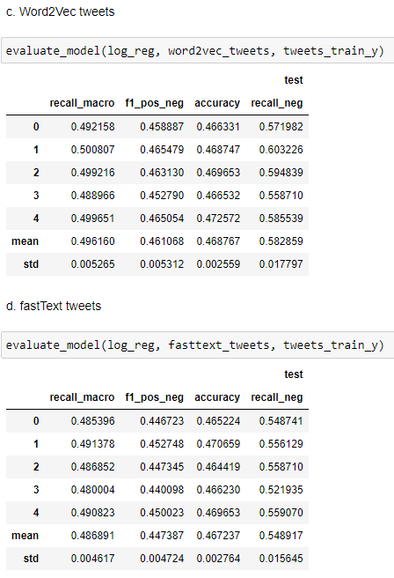
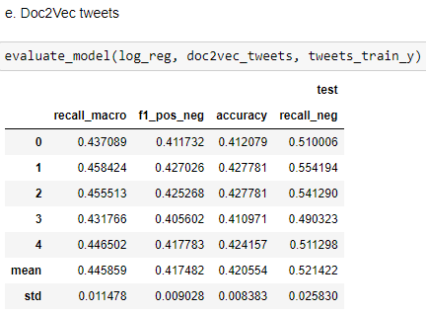
TF-IDF tweets scored the highest in Macro-Recall (63.20%), and even in our secondary metrics such as our recall for the negative class (63.97%).
We will choose TfidfVectorizer as our feature extraction technique to vectorize our tweets.
We will pass this vectorized texts to a neural network, possibly to create a model with a better performance.

Slide 30
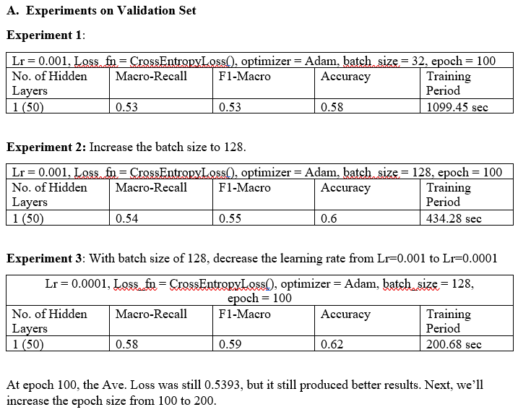
Neural network architecture and hyperparameter experiments

Slide 31
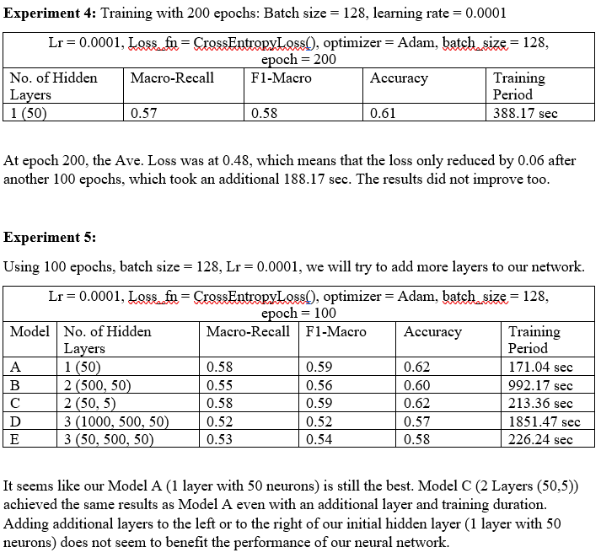
Neural network architecture and hyperparameter experiments

Slide 32
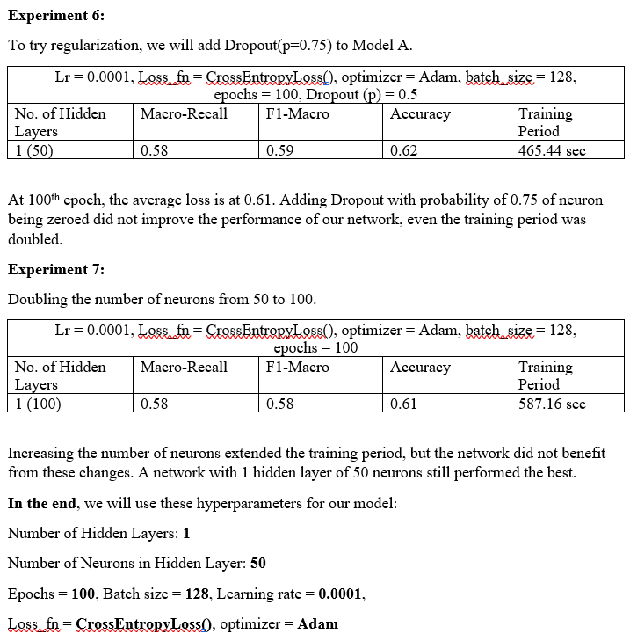
Neural network architecture and hyperparameter experiments

Slide 33
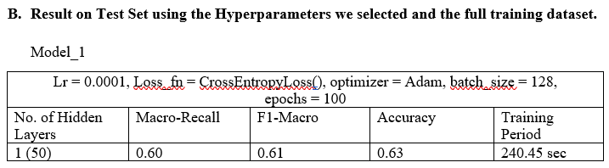
Neural network architecture and hyperparameter experiments

Slide 34
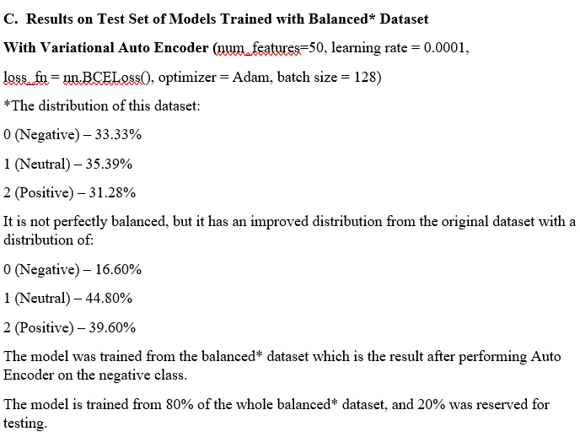
Neural network architecture and hyperparameter experiments

Slide 35
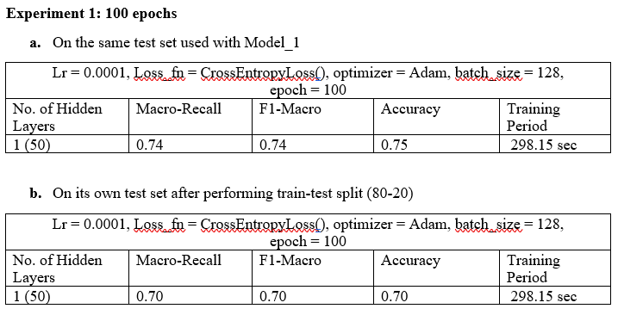
Neural network architecture and hyperparameter experiments

Slide 36
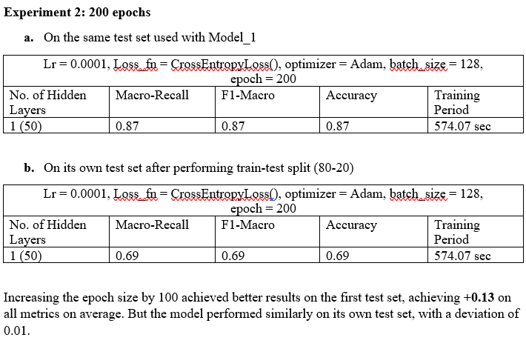
Neural network architecture and hyperparameter experiments

Slide 37
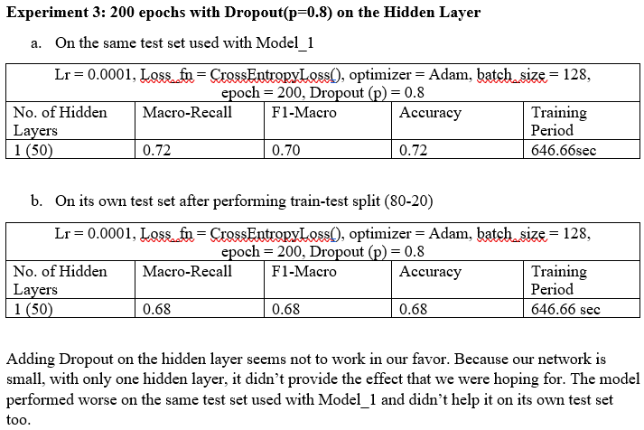
Neural network architecture and hyperparameter experiments

Slide 38
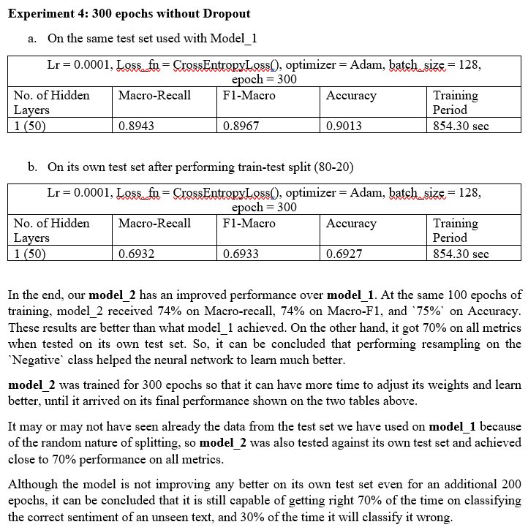
Neural network architecture and hyperparameter experiments

Slide 39

Thank you for listening.

